Slide 1
Some Things I Missed From Last Class
Cherry has an outdated definition of Dalton and amu (CARBON NOT OXYGEN)
Please be respectful of patients, avoid walking in typically occupied hallways, mindful of speech, volume, workers, and food
Post-Lectures due the weekend of class (very lenient IF you lmk ahead of time)
Navigating Canvas, Syllabus, and Cherry
Post-Lecture Answers and my comments (its not that deep)
Pronouns? Optional
The slides start to look better after this week I swear
I’m new, I talk to fast, PLEASE interrupt me if I’m talking too fast and give feedback often (after class) if you are comfortable
  Tism? I don’t look at faces ☹ trying to get better, hard to tell if y’all are understanding
The bug

Slide 2
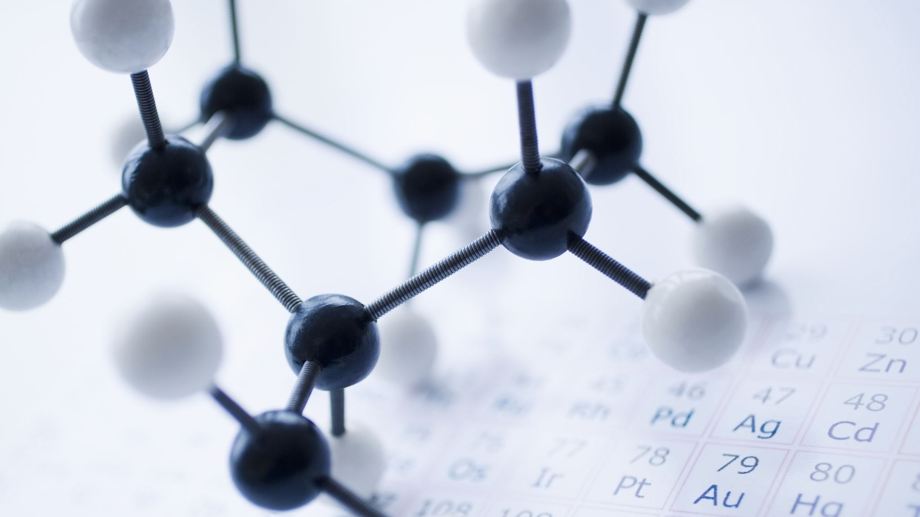
Atomic and Nuclear Physics
RTT4220 – Lecture #2
Kedree Proffitt
WSU
09/04/2025
Notes:
-----------------

Slide 3
The Nucleus
How nucleating!
Notes:
Bohr Model and History of Xray
Nuclear Composition
Nuclear Notation
Nuclear Families
Nuclear States
Nuclear Stability
Line of Stability

Slide 4
Discovery of Atoms
X-rays and radioactivity discovered BEFORE Rutherford Atom Model (1895 – Roentgen, 1896 – Becquerel)
Next model says atoms consist of a nucleus of positive charge with a negative charge outside (1910 – Rutherford)
Under Rutherford’s model the shell should collapse, Bohr’s Model introduces electron SHELLS with Pauli’s Exclusion Principle (1913 – Bohr, 1925 – Pauli)
Modern model says the electrons exist in wibbly wobbly timey wimey cloud

Slide 5
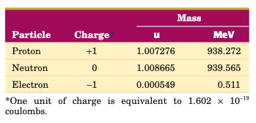

Nuclear Composition
Atoms are made of PROTONS ($P$), NEUTRONS ($N$), and ELECTRONS ($e^{−}$)
Protons and neutrons are NUCLEONS
Nuclear density is VERY HIGH, electron cloud density is VERY LOW (mostly empty, like space!)

Slide 6
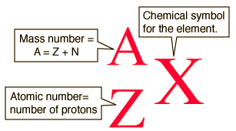
Nuclear Notation
Standard Notation shown below
Common notation omits Z and N. In text form it looks like: Co-60 or Cobalt-60
  N=A−Z

Slide 7

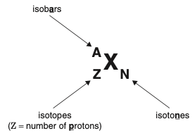
Nuclear Families
Isomers – Same element and # nucleons, different energy state
(Tc-99 / Tc-99m)
Isobars – Same # nucleons, different element
(Ca-40 / K-40)
Isotones – Same # neutrons, different element
(B-12 / C-13)
Isotopes – Same element, different # nucleons
(Co-59 / Co-60)

Slide 8
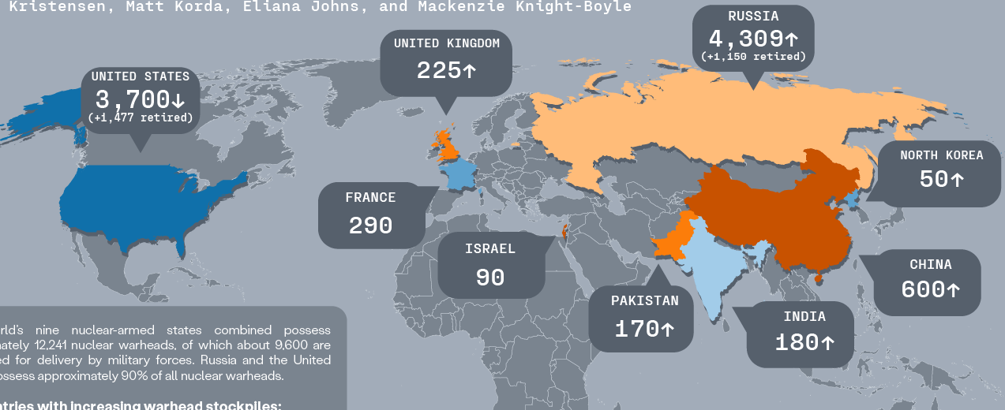
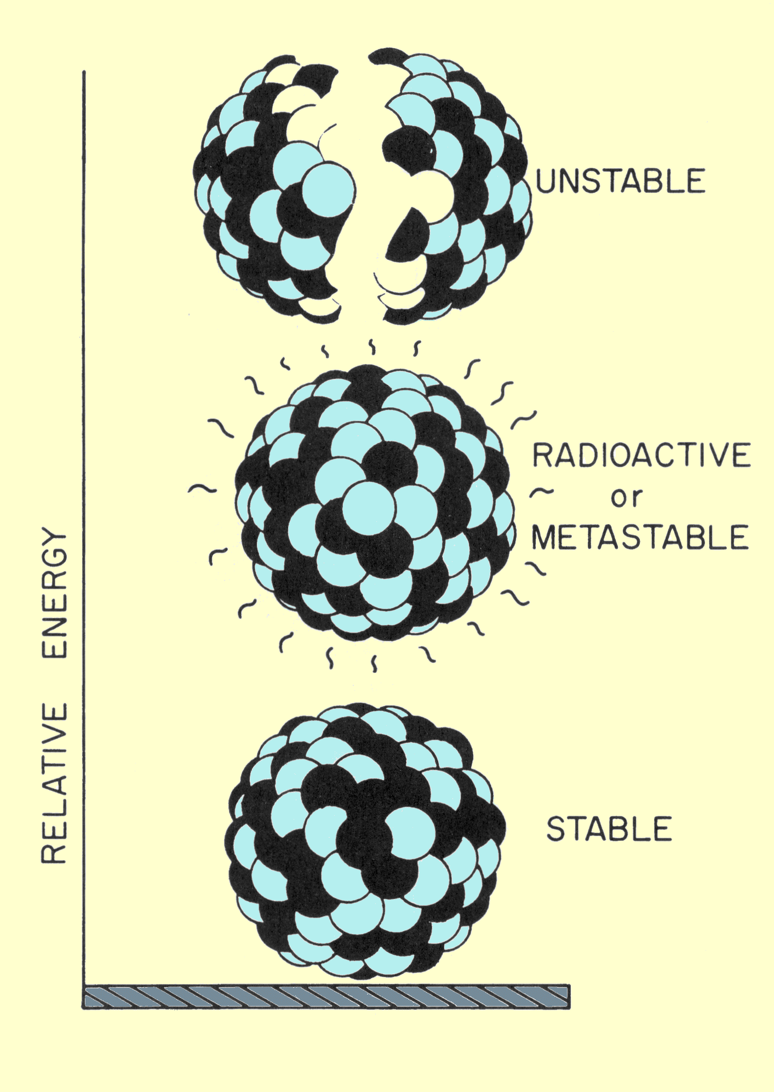
Nuclear States
Three general states:
  Stable (Ground)
  Metastable
  Excited
Excited states are transitory (very short lived)
Metastable states are longer lived (dividing line about 1 picosecond)
Ground state is the lowest energy (most stable)
Tc-99m is a famous metastable state
Notes:
1 picosecond is time it takes light to travel 0.3 mm according to wikipedia

Slide 9
Nuclear Stability
BINDING ENERGY is the energy required to take a nucleon out of the nucleus (energy required to break apart nucleus)
Binding energy per nucleon is a useful metric
  Peaks at A~=60
Atoms have stable isotopes despite the “tug-of-war” between nuclear forces and electromagnetic repulsion (gluons vs positive charge)
The LINE OF STABILITY follows a weird trend:
  Light Elements → # Neutrons ~= # Protons
  Heavy Elements → # Neutrons ~= 1.5x # Protons (For every 2 protons, 3 neutrons)
  Even numbered Proton/Neutron atoms tend to be more stable (“Magic Numbers”)

Slide 10
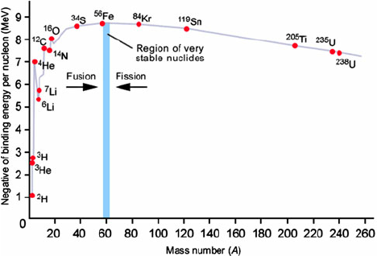
Binding Energy Per Nucleon
Notes:
Mention stars, supernovae, fusion vs fission

Slide 11
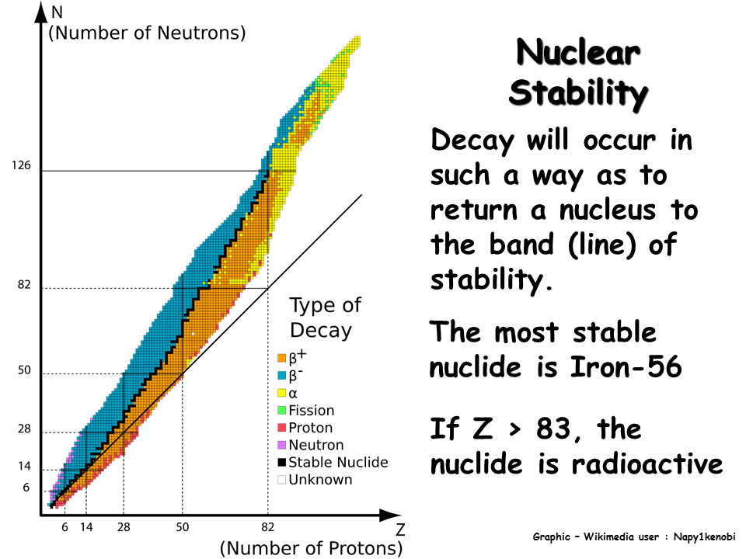
Line of Stability

Slide 12

Mass Energy Equivalence
Don’t think too much into it
We can represent energy as mass and vice versa
$$E=mc^{2}$$

Slide 13

Mass Energy Equivalence Practice - 1
Prove that 1 amu is approximately 932 MeV using Einstein’s Mass Energy Equivalence Equation
$$E=mc^{2}→E=\left(1.661×{10}^{−27} \text{kg}\right)×{\left(3×{10}^{8} \frac{}{}\right)}^{2}=1.49×{10}^{−10} \text{J}→\frac{1.49×{10}^{−10}}{1.6×{10}^{−19}} \frac{\text{eV} \text{J}}{\text{J}}=9.32×{10}^{8} \text{eV}=932 \text{MeV}$$
This rule of thumb is very useful!

Slide 14

Mass Energy Equivalence Practice - 2
What is the energy representation of an electron’s rest mass in keV?
$E=mc^{2}→E=\left(9.1×{10}^{−31} \text{kg}\right)×{\left(3×{10}^{8} \frac{}{}\right)}^{2}$
$$=8.19×{10}^{−14} \text{J}→\frac{8.19×{10}^{−14}}{1.6×{10}^{−19}} \frac{\text{eV} \text{J}}{\text{J}}=5.11×{10}^{5} \text{eV}=511 \text{k}\text{eV}$$

Slide 15

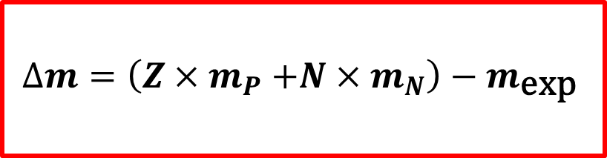






Mass Defect and Binding Energy
The MASS DEFECT is used to find the BINDING ENERGY of a nucleus
Calculate mass defect in amu, use Einstein’s Equation to convert mass defect into binding energy
Nuclear mass (sum of all nucleon mass’) $≠$ Experimental mass
$$∆m=\left(Z{×m}_{P}+N×m_{N}\right)−m_{\text{exp}}$$
$$\text{BE}=∆m×c^{2}$$

Slide 16
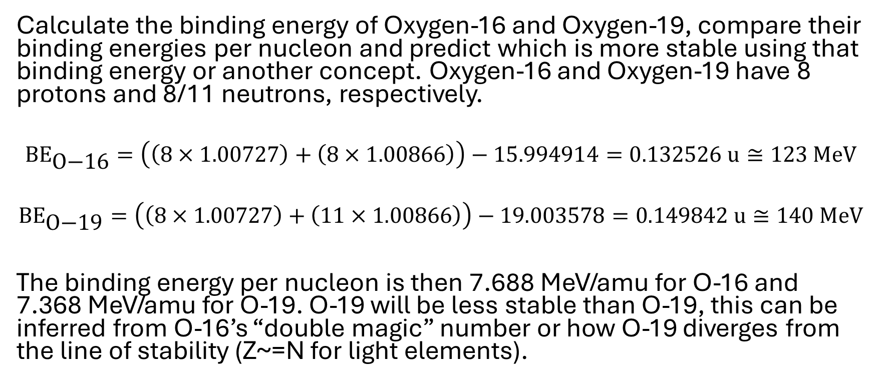
Binding Energy Practice
Mass | Energy (amu)
Total Mass O-16 | 15.994914
Total Mass O-19 | 19.003578
Neutron Rest Mass | 1.00866
Proton Rest Mass | 1.00727
Calculate the binding energy of Oxygen-16 and Oxygen-19, compare their binding energies per nucleon and predict which is more stable using that binding energy or another concept. Oxygen-16 and Oxygen-19 have 8 protons and 8/11 neutrons, respectively.
$${\text{BE}}_{\text{O}\text{−16}}=\left(\left(8×1.00727\right)+\left(8×1.00866\right)\right)−15.994914=0.132526 \text{u}≅123 \text{MeV}$$
$${\text{BE}}_{\text{O}\text{−19}}=\left(\left(8×1.00727\right)+\left(11×1.00866\right)\right)−19.003578=0.14\text{9842} \text{u}≅1\text{40 }\text{MeV}$$
The binding energy per nucleon is then 7.688 MeV/amu for O-16 and 7.368 MeV/amu for O-19. O-19 will be less stable than O-19, this can be inferred from O-16’s “double magic” number or how O-19 diverges from the line of stability (Z~=N for light elements).
Notes:
Update practice to make less complex or spread out to multiple problems. Not showing amu conversion to kg and then BE in J to eV was very confusing

Slide 17
The Electrons
Electrifying?
Notes:
Electron Shells
Electron Binding Energy
Char. Radiation?
Auger Effect?

Slide 18

Electron Shells
Each SHELL is comprised of SUBSHELLS which are comprised of ORBITALS which are occupied by ELECTRONS
  Shells → Subshells → Orbitals → Electrons
We give these letters and numbers to describe them:
  Shells: Principle Quantum Number $n$ (1: K-Shell, 2: L-Shell…)
  Subshells: Orbital Angular Momentum Quantum Number $l$ (0, 1, … $n−1$)
  Orbitals: Magnetic Quantum Number $m_{l}$ ($±l$ integers and 0)
  Electrons: Electron Spin Quantum Number $m_{s }\left(±\frac{1}{2}\right)$

Slide 19
Electron Binding Energy
Electrons “occupy” lowest energy states first (K-shell → L-shell…)
Binding Energy is the energy required to remove an electron from an atom
Binding energy relies on a few factors:
  Increases as the nucleus gains charge
  Decreases as electrons occupy FURTHER orbitals
As electrons transition from excited to deexcited state (i.e. L→K), the energy released is the difference in binding energies
We use Energy level diagrams to represent these transitions

Slide 20
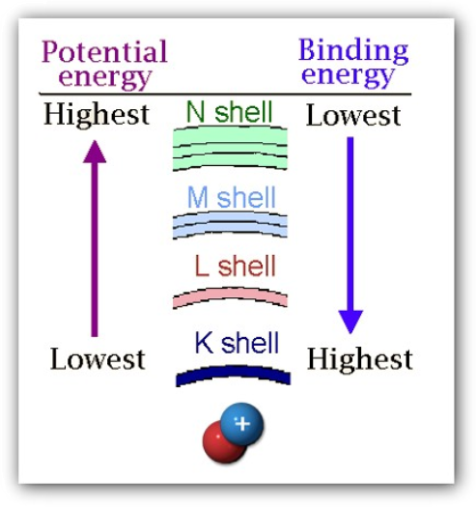
Electron Binding Energy

Slide 21
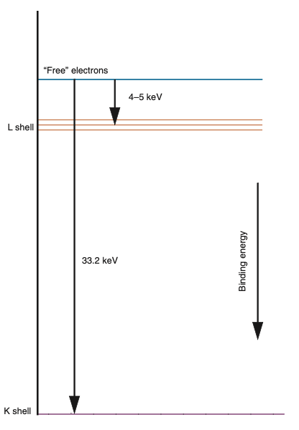

Electron Binding Energy
The energy level diagram at the right shows the various binding energies for Iodine electrons.
$$∆E=E_{y}−E_{x}$$

Slide 22

Electron Binding Energy Practice
What would be the energy released from an Iodine electron deexcitation from the L-shell to the K-shell?
$$∆E=E_{y}−E_{x}→∆E=33.2 \text{keV}−5? \text{keV}≅28 \text{keV}$$
The discrepancy is because the spin of an electron interacts with the angular momentum (spin-orbit coupling). The number of possible binding energies is found by: $2n−1$
Typically, these are denoted by: $L_{1}2s$, $L_{2}2p_{1/2}$, $L_{3}2p_{3/2}$, etc.
Notes:
Three

Slide 23
Characteristic Radiation
The emitted energy of an electron transition is in the form a photon called CHARACTERISTIC RADIATION
Characteristic X-rays are unique for given atomic and electric states (things get funky IRL)
For most cases the char. x-rays are well-known and predictable
Each ELEMENT has predetermined binding energies due, thus a unique array of char. x-rays

Slide 24
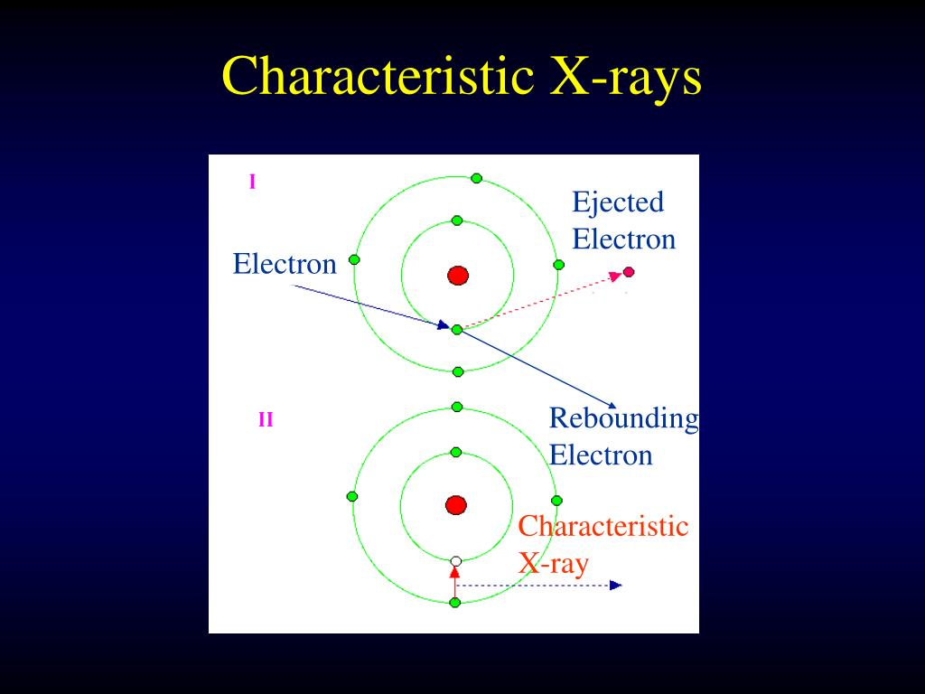
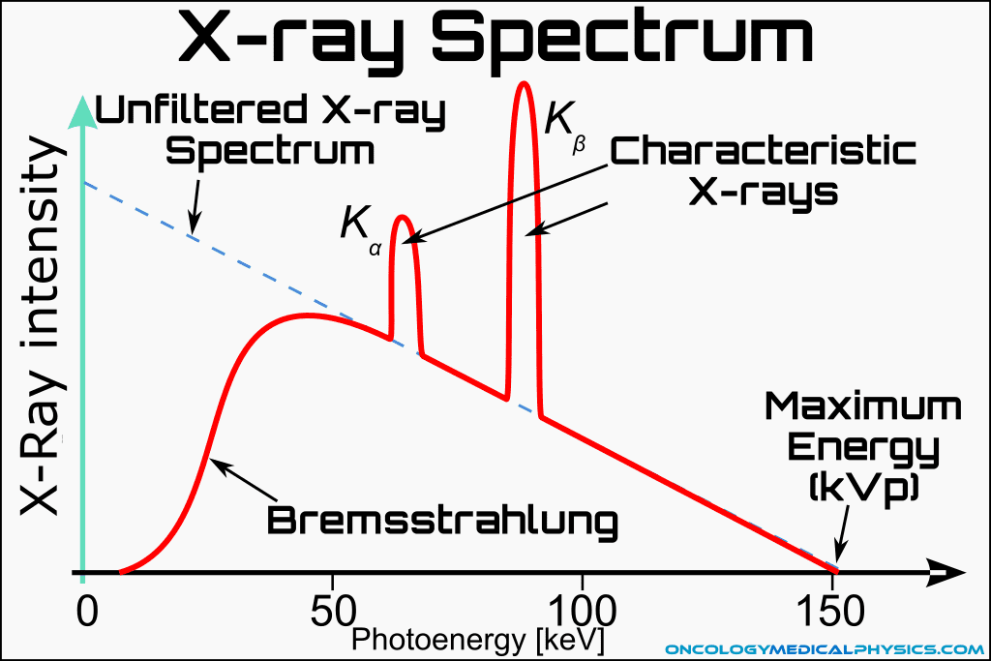
Characteristic Radiation

Slide 25
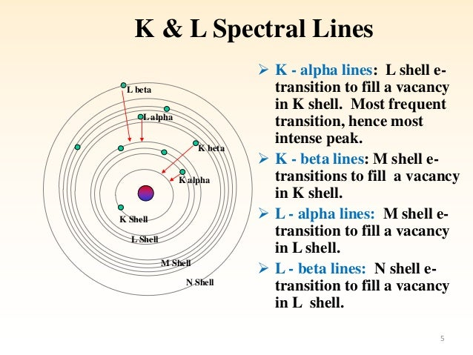
Characteristic Radiation Notation

Slide 26
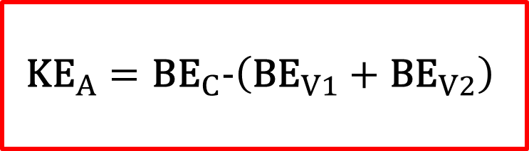
Auger Effect
A competing process to Characteristic Radiation
An AUGER ELECTRON is emitted instead of an x-ray
Results in TWO orbital vacancies → more Char. Radiation/Auger
The kinetic energy of the Auger Electron is (roughly):
$${\text{KE}}_{A}={\text{B}\text{E}}_{C}−\left({\text{BE}}_{V1}+{\text{BE}}_{V2}\right)$$

Slide 27
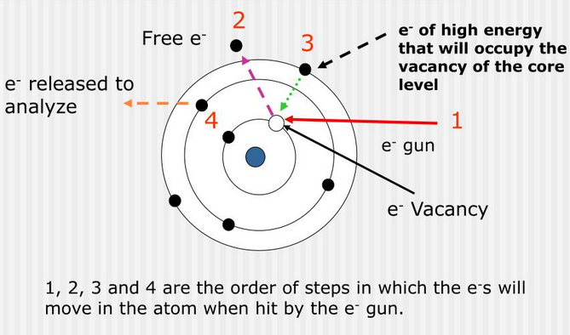
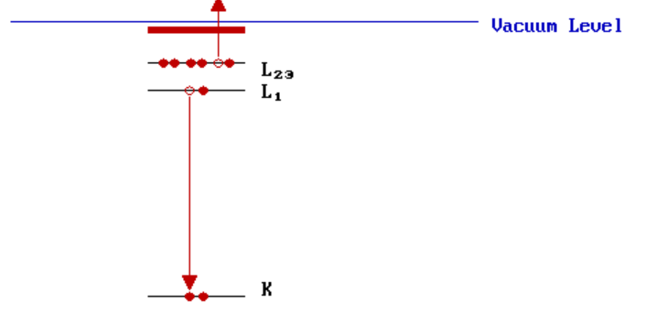
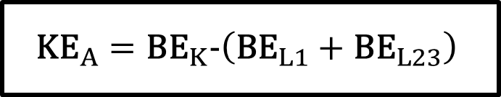
Auger Effect
Example:
$${\text{KE}}_{A}={\text{B}\text{E}}_{K}−\left({\text{BE}}_{L1}+{\text{BE}}_{L23}\right)$$

Slide 28
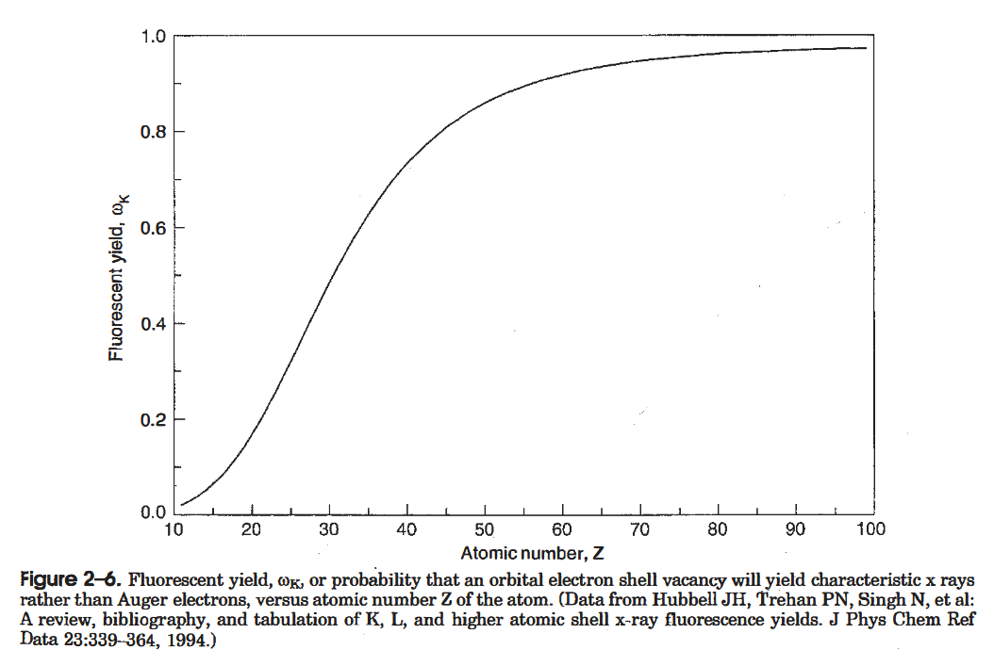

Fluorescent Yield
Defined as the probability of CHARACTERISTIC RADIATION (vs Auger Effect) for a vacancy
  Hence, Fluoro-
  Use $ω$ for total, $ω_{K}$ and $ω_{L}$ for K-Shell and L-Shell
Heavier elements have HIGHER $ω$

